Slide 1
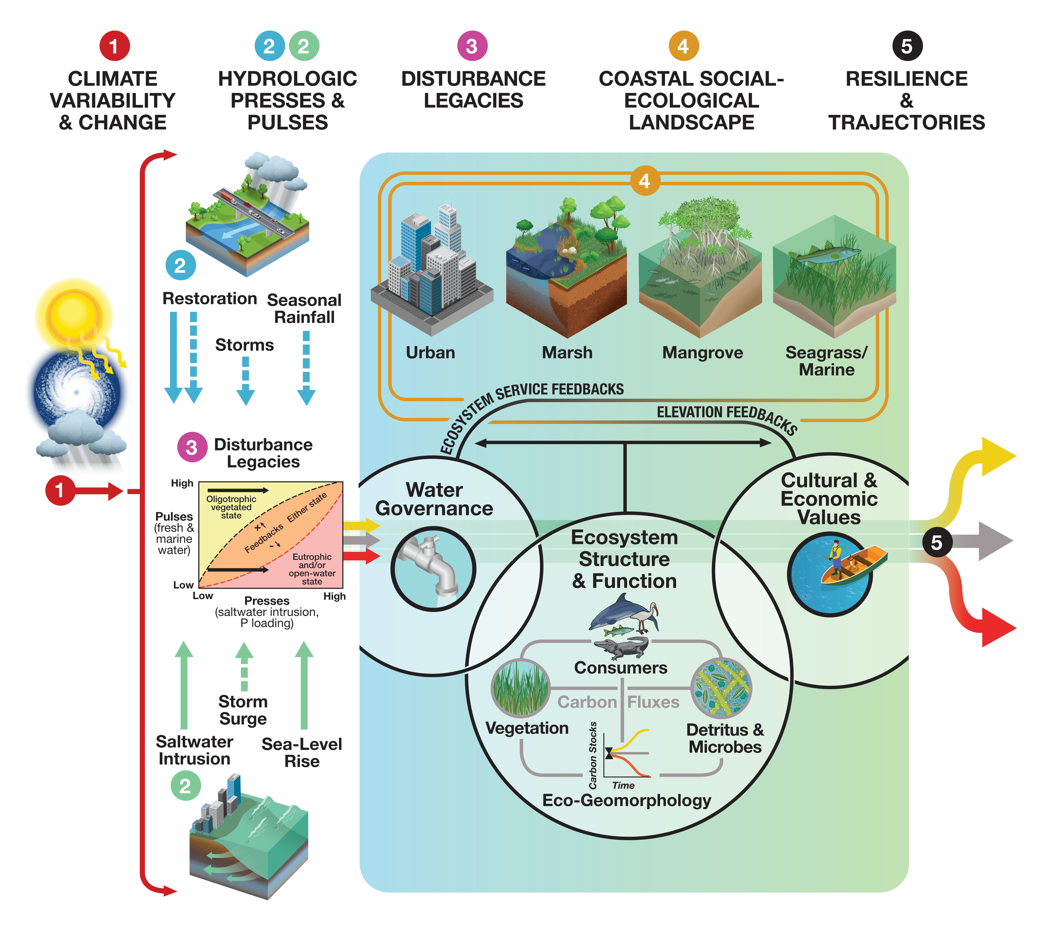
Poster Title
Poster Authors
Include the content of your poster here.
Please reflect on how your research addresses the FCE V proposal questions and conceptual framework as you prepare your poster.
Question 1 (Climate Variability & Change): How are temperatures and the timing and magnitude of precipitation changing in urban and non-urban regions of coastal landscapes?
Question 2 (Hydrologic Resources & Stressors): How are amplified hydrologic presses and pulses changing spatiotemporal variability in surface water and groundwater chemistries?
Question 3 (Vegetation): How are increases in hydrologic presses and pulses changing the structure (composition, distribution), and function (productivity) of coastal macrophyte and microbial mat communities?
Question 4 (Consumers): How will increasing hydrologic presses and pulses influence basal resources and energy pathways across freshwater-to-marine gradients to determine the
structure and function of coastal food webs?
Question 5 (Detritus & Microbes): How are increasing hydrologic presses and pulses of fresh and marine water affecting organic matter processing and microbial community functions in
wetland ecosystems exposed to varying disturbance legacies?
Question 6 (Eco-Geomorphology): How do increases in marine and freshwater presses and pulses interact with disturbance legacies to drive fluxes and net ecosystem storage of carbon that influence resilience and trajectories of coastal wetlands?
Question 7 (Social-Ecological Landscape): How do disturbance legacies, climate impacts and restoration activities impact values of ecosystem services and decisions that drive social-ecological resilience in urban coastal communities?
Conceptual Framework & Theoretical Context of FCE V. (1) Changing frequency and intensity of rainfall, temperature, and storms influence (2) hydrologic presses (solid arrows) and pulses (dashed arrows) from fresh (blue) and marine (green) sources that can cause (3) disturbance legacies (e.g., eutrophic and/or open-water state) that influence how (4) social-ecological systems are structured and how they function to influence (5) resilience and ecosystem development trajectories (colored arrows: yellow increasing, gray maintaining, red declining; Kominoski et al., 2018). Human decisions and values about water and dynamic structure and function of natural ecosystems feedback to influence available ecosystem services and maintain soil and sediment elevation feedbacks that determine resilience and trajectories over time. Figure by Hiram Henriquez, Univ. of Miami.
This material is based upon work supported by the National Science Foundation through the Florida Coastal Everglades Long-Term Ecological Research program under Cooperative Agreement DEB-2025954. Any opinions, findings, conclusions, or recommendations expressed in the material are those of the author(s) and do not necessarily reflect the views of the National Science Foundation.
Include organization logo(s) here

