Slide 1
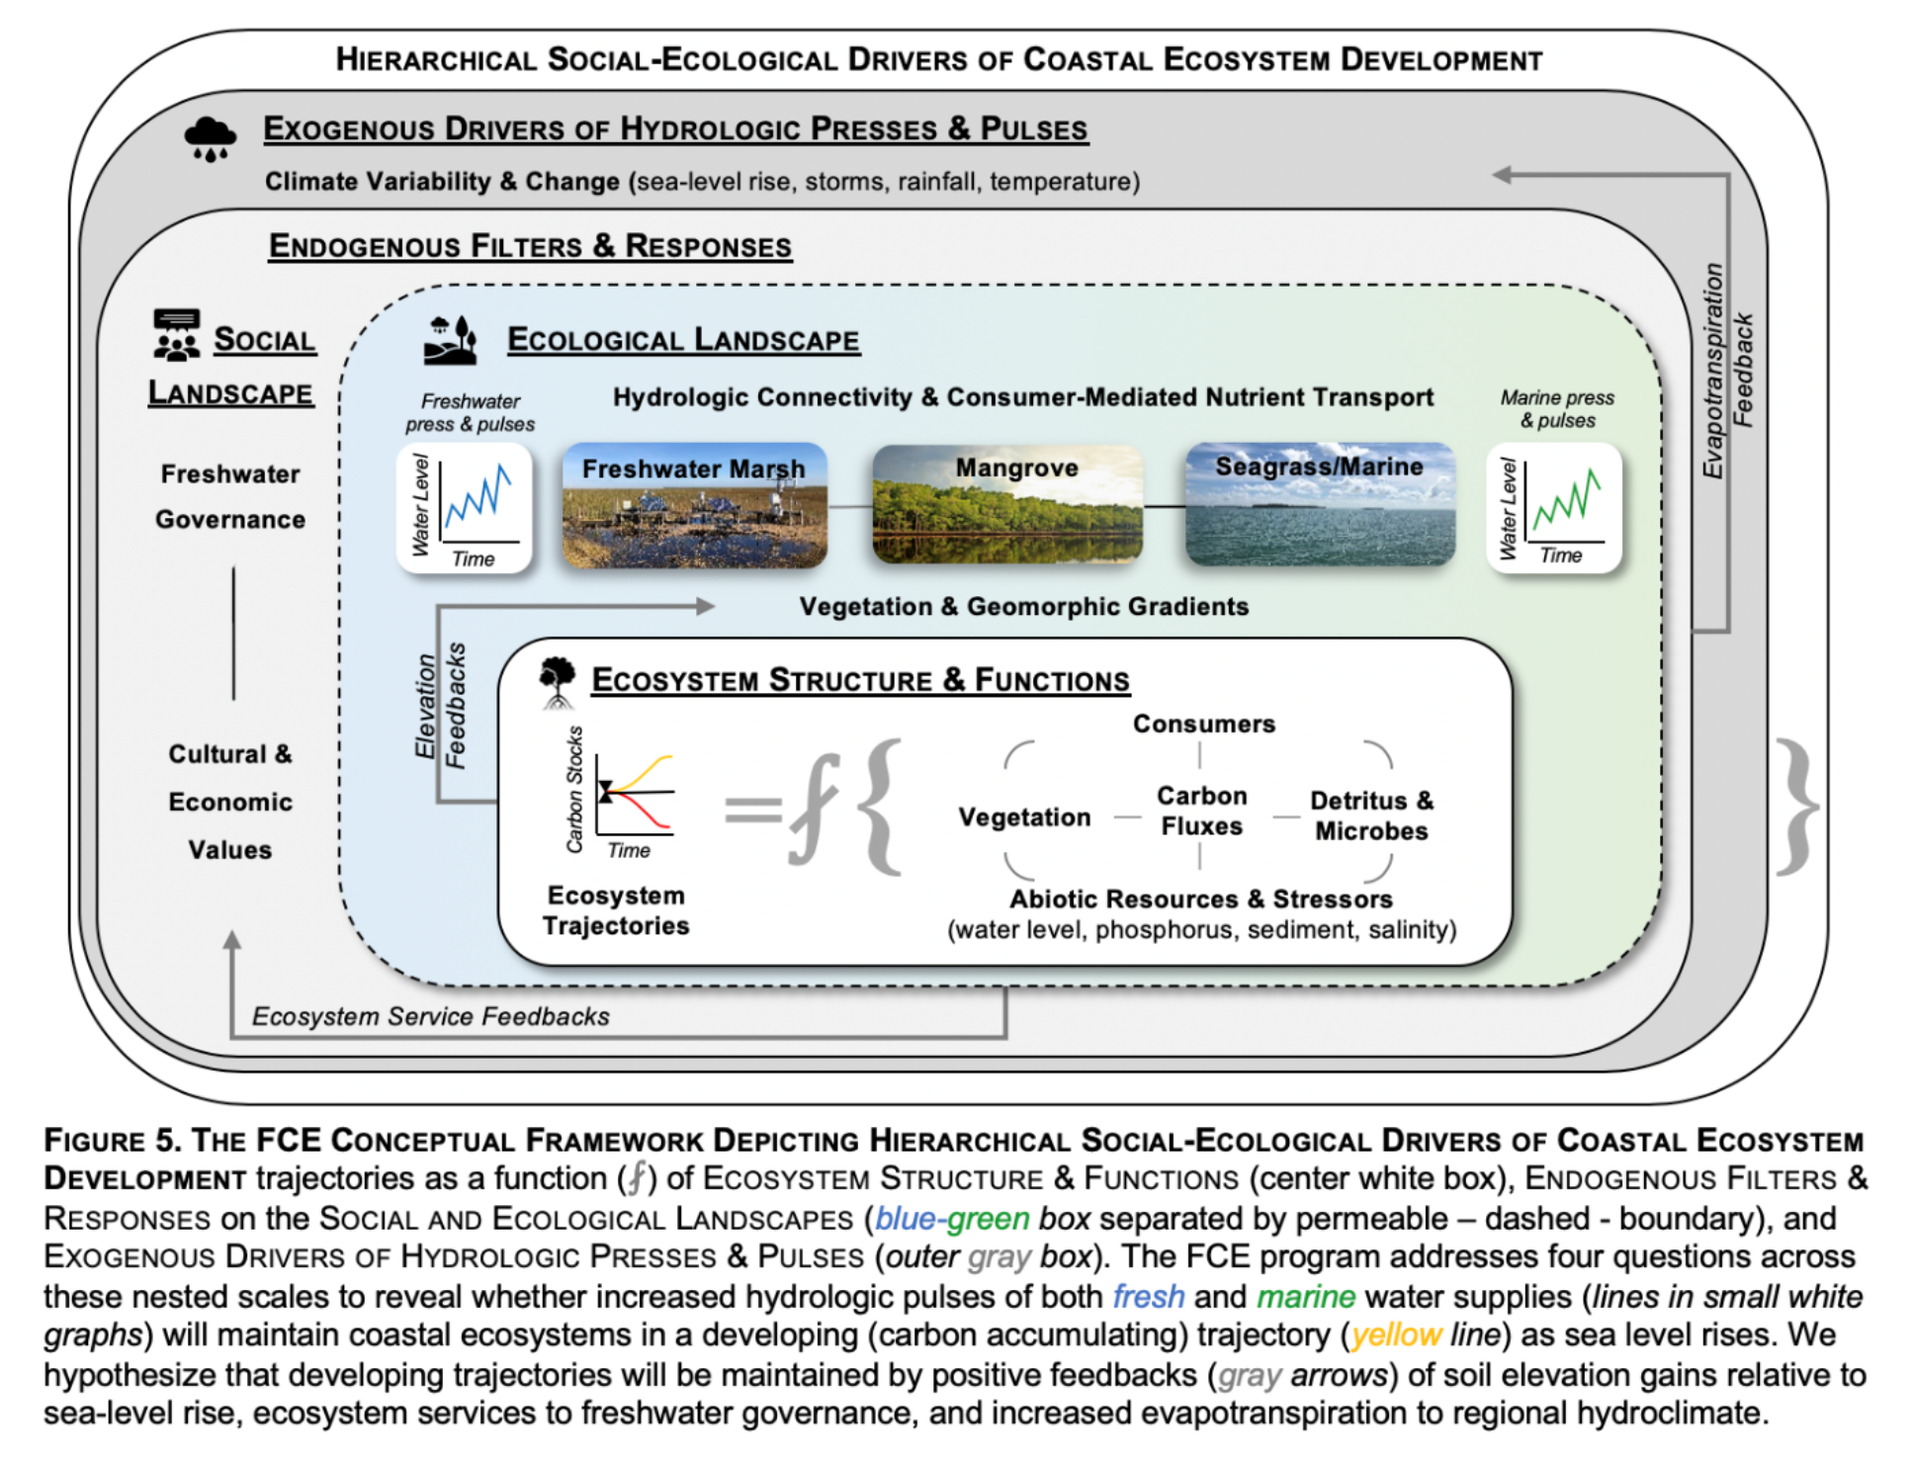
Poster Title
Poster Authors
Include the content of your poster here.
Please reflect on how your research addresses the FCE 4.2 proposal questions and conceptual framework as you prepare your poster.
QUESTION 1 [EXOGENOUS DRIVERS OF HYDROLOGIC PRESSES & PULSES]: How will global climate change alter regional climate variability and extremes – the exogenous drivers of hydrologic pulses and presses?
QUESTION 2 [ENDOGENOUS FILTERS & RESPONSES – SOCIAL LANDSCAPE]: How will shifting cultural and economic values of changing ecosystem functions and services influence governance of freshwater restoration?
QUESTION 3 [ENDOGENOUS FILTERS & RESPONSES – ECOLOGICAL LANDSCAPE]: How does geomorphology (elevation, soil depth) influence hydrologic connectivity to fresh and marine water pulses to determine the succession of vegetation and transport of nutrients by consumers?
QUESTION 4 [ECOSYSTEM STRUCTURE & FUNCTIONS]: How will increased pulses of fresh and marine water and their associated resources change ecosystem structure and functions that control ecosystem development trajectories in coastal ecosystems facing the press of accelerating sea-level rise?
Feel free to use the icons associated with each question in your poster.
This material is based upon work supported by the National Science Foundation through the Florida Coastal Everglades Long-Term Ecological Research program under Cooperative Agreement DEB-2025954. Any opinions, findings, conclusions, or recommendations expressed in the material are those of the author(s) and do not necessarily reflect the views of the National Science Foundation.
Include organization logo(s) here

